Slide 1
Request Scale
Observation 5 (FS): Linux buffer I/O limitation (page cache) limits request scale

Slide 2
CS 736: Advanced Operating Systems Andrea Arpaci-Dusseau Lecture 4: Unwritten Contract of SSDs
Questions for Today:
What is the unwritten contract of SSDs?
- How are SSDs structured and how should they be used to obtain best performance?
Do existing applications and file systems adhere to this unwritten contract?
To do for Tuesday
Read papers (GraphChi and Xstream – large-scale graph computation) and answer question
Meet with Reading Group
Get ready for Mini-Project…

Slide 3

The Unwritten Contract of Solid State Drives
Jun He, Sudarsun Kannan,
Andrea C. Arpaci-Dusseau, Remzi H. Arpaci-Dusseau
Department of Computer Sciences, University of Wisconsin - Madison
Notes:
Good afternoon, I am Jun. I am here to present our work about the unwritten contract of solid state drives.

Slide 4
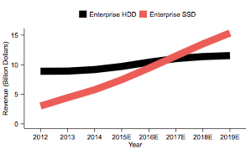
Enterprise SSD revenue is expected to exceed enterprise HDD in 2017
HDD
2017
SSD
Source: Gartner, Stifel Estimates
https://www.theregister.co.uk/2016/01/07/gartner_enterprise_ssd_hdd_revenue_crossover_in_2017/
Notes:
As you probably has noticed, more and more SSDs are used. This figure shows that enterprise SSD revenue is expected to exceed enterprise HDD this year.

Slide 5

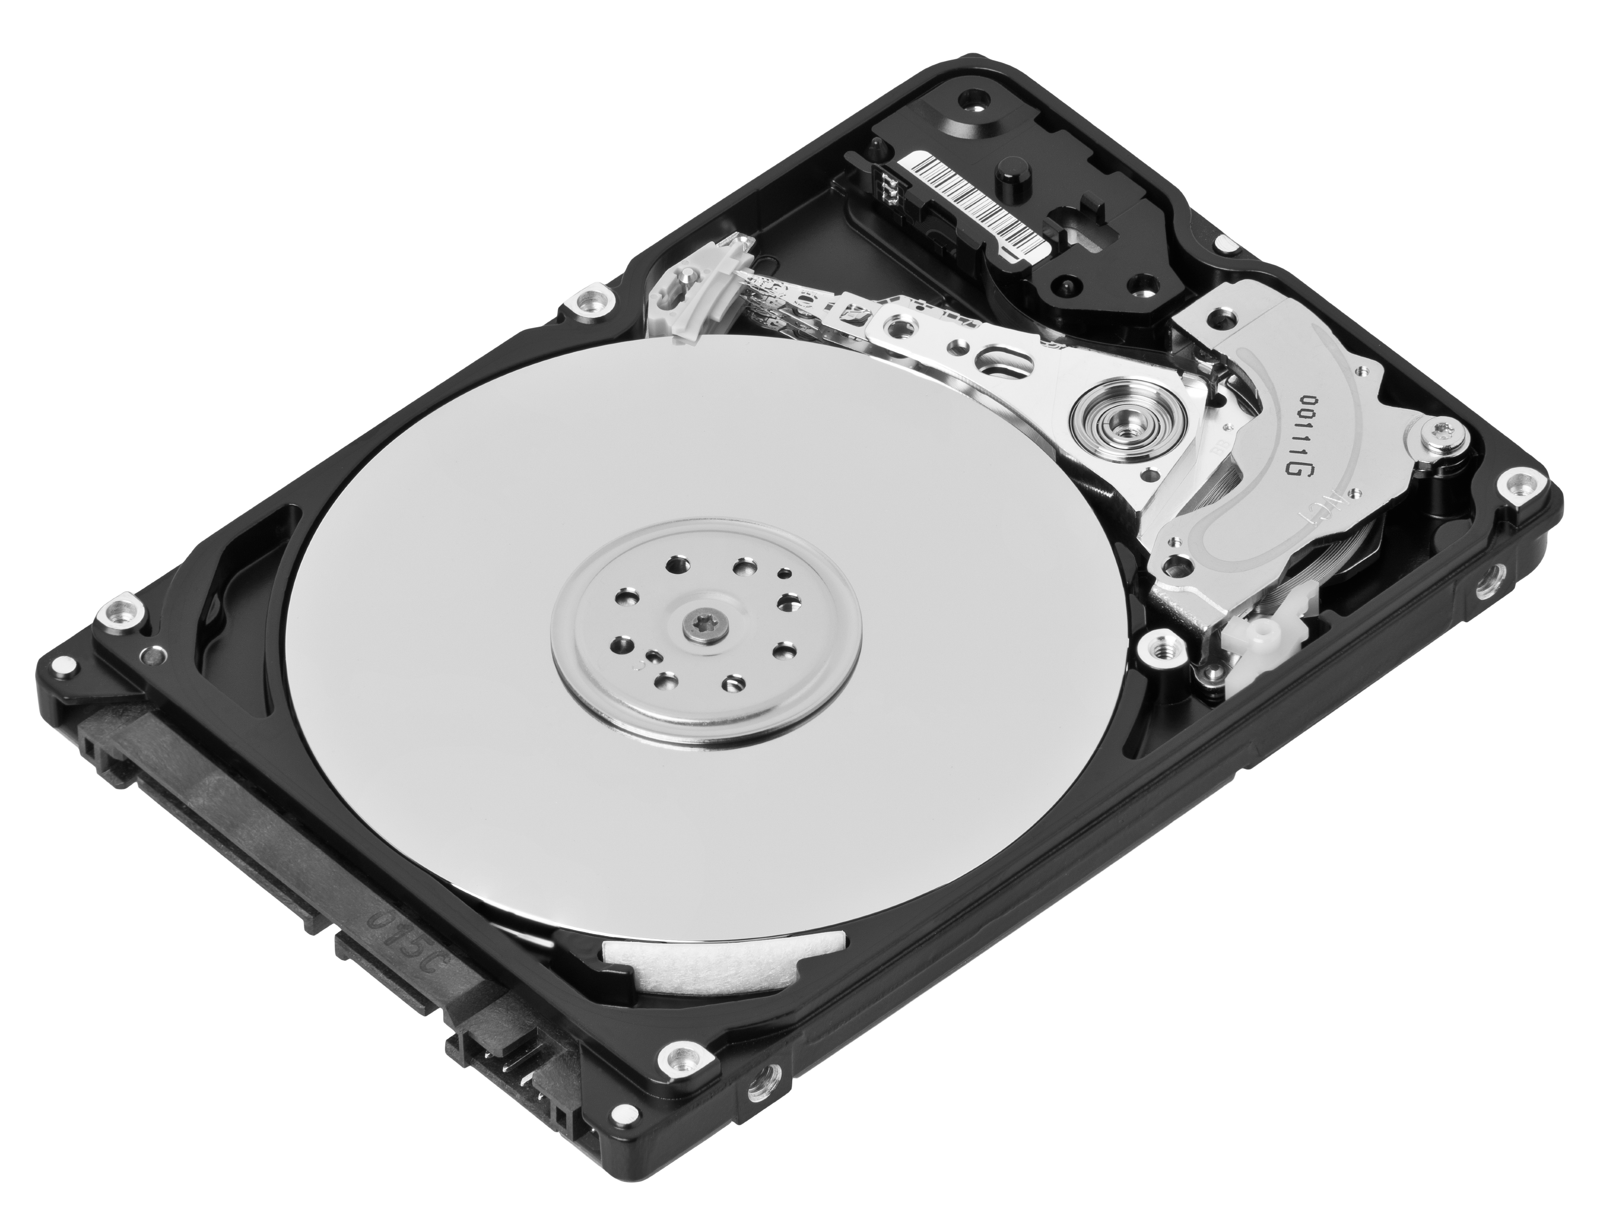
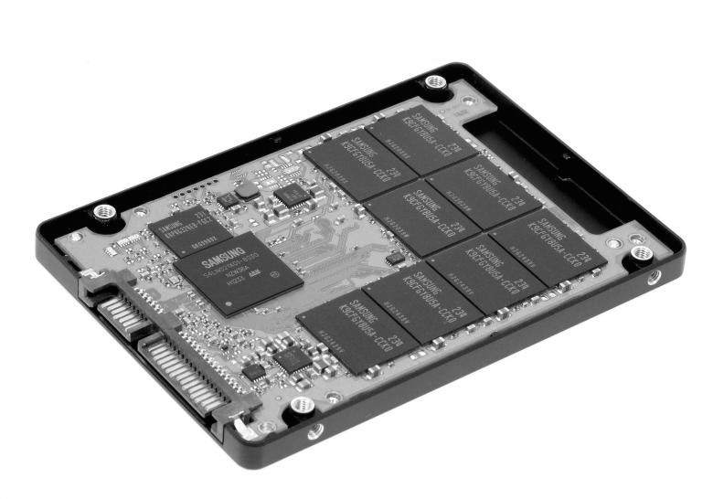
Storage stack is shifting from the HDD era to the SSD era
App
App
for
SSD
?
App
?
FS
FS
FS
for
SSD
?
?
Notes:
As we shift from HDDs to SSDs, most applications and file systems remain the same. One question is whether these old applications and file systems work well. Also, we need to know whether the SSD work well for such old applications and file systems.
As SSDs become popular, there are also applications and file systems optimized for SSDs. We also would like to know whether such new applications and file systems work well on SSDs and whether SSDs work well for them.

Slide 6
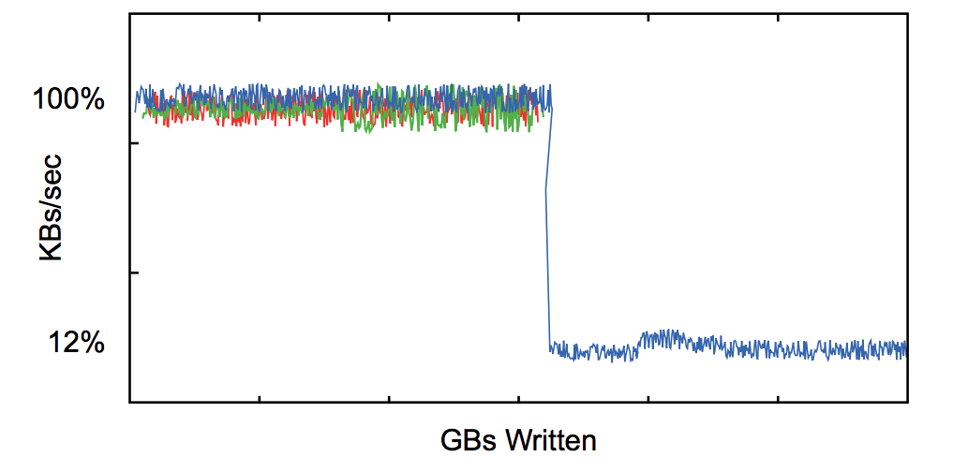
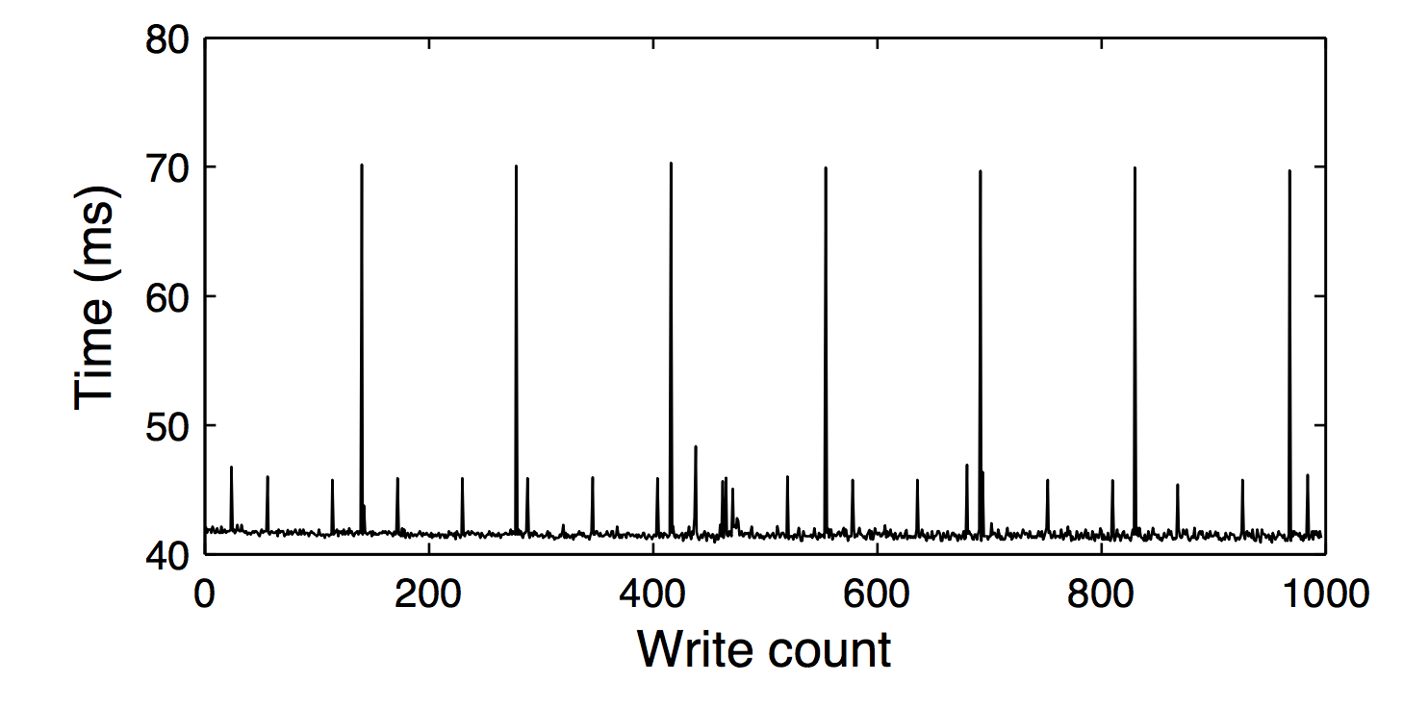

The consequences of misusing SSDs
Performance degradation
Performance fluctuation
Early end of device life
http://crestingwave.com/sites/default/files/collateral/velobit_whitepaper_ssdperformancetips.pdf
S. Boboila and P. Desnoyers. Write Endurance in Flash Drives: Measurements and Analysis. In Proceedings of the 8th USENIX Symposium on File and Storage Technologies (FAST ’10), San Jose, California, February 2010
Notes:
If the applications and file systems do not work well with SSDs, you will have performance degradation, fluctuation. Your device may die sooner.

Slide 7
What is the right way to achieve high performance on SSDs?
Block Device Interface: read(range), write(range), discard(range)
HDD Unwritten Contract
SSD Unwritten Contract
?
Sequential accesses are best
Nearby accesses are more efficient than farther ones
MEMS-based storage devices and standard disk interfaces: A square peg in a round hole?
Steven W. Schlosser, Gregory R. Ganger
FAST’04
Notes:
We know that misuses of SSD could cause problems. But what’s the right way to achieve high performance on SSDs?
Block devices provide a uniform interface. You can read, write, or discard a range. But different ways of using the interface can have very different performance. Schlosser and Ganger have studied the unwritten contract of HDD, which specifies the right way to use HDD. But, what’s the unwritten contract of SSDs?
In this paper, we have summarized five rules of the unwritten contract from existing studies and our experience of implementing an SSD simulator. Users of SSD could follow these rules to get high performance. Later, we will introduce these rules one by one.

Slide 8
What is the right way to achieve high performance on SSDs?
Existing studies
Experience of implementing an SSD simulator
Analysis of experiments
SSD Unwritten Contract
Request Scale
Locality
Aligned Sequentiality
Grouping by Death Time
Uniform Data Lifetime
Notes:
We know that misuses of SSD could cause problems. But what’s the right way to achieve high performance on SSDs?
Block devices provide a uniform interface. You can read, write, or discard a range. But different ways of using the interface can have very different performance. Schlosser and Ganger have studied the unwritten contract of HDD, which specifies the right way to use HDD. But, what’s the unwritten contract of SSDs?
In this paper, we have summarized five rules of the unwritten contract from existing studies and our experience of implementing an SSD simulator. Users of SSD could follow these rules to get high performance. Later, we will introduce these rules one by one.

Slide 9
Do the current apps/FSes comply with the unwritten contract of SSDs?
for
SSD
SQLite
(RollBack)
SQLite
(WAL)
5 apps
LevelDB
RocksDB
Varmail
for
SSD
3 file systems
ext4
F2FS
XFS
Contract
Rule 1
Rule 2
Rule 3
Rule 4
Rule 5
Notes:
Now we know that SSDs have an unwritten contract. The next question is “Do the current applications and file systems comply with the unwritten contract?”
To answer this question, we run combinations of applications and file systems, and check whether they comply with each of the rules of the unwritten contract. For example, we ran SQLite on top of F2FS and check whether they comply with rule No. 4.

Slide 10
We built a sophisticated SSD simulator and workload analyzer
We made 24 detailed observations
We learned several high-level lessons

Slide 11
Outline
Overview
SSD Unwritten Contract
Violations of the Unwritten Contract
Conclusions
Notes:
We have just finished the overview of the talk.
We will introduce the rules of SSD unwritten contract and

Slide 12
SSD Background
Controller
RAM
FTL
address mapping
garbage collection
wear-leveling
Mapping Table
Data Cache
Channel
Channel
Channel
Block
Block
Block
P
P
P
P
P
P
P
P
P
P
P
P
P
P
P
P
P
P
P
P
P
P
P
P
P
P
P
…
…
…
…
…
…
…
…
…
…
…
…
…
Notes:
Before introducing the rules, let’s look at some background of SSD. There are pages inside an SSD. Each page is, for example, 4KB. Multiple pages form a block. A block is usually 2MB. Because of the property of flash, you can only overwrite a page after erasing the whole block.
Multiple blocks form a channel. There can be multiple channels. Channels can work independently. Channels are connected with a bus. The bus is connected to a controller. In the controller, there is a very important piece of software, called FTL. FTL manages address mapping, garbage collection and wear-leveling. The controller is connected to some RAM. The RAM stores mapping table and data cache.

Slide 13
Flash
Hold charge in cells. No moving parts!
Inherently parallel.
No seeks!
Notes:
U盘就是flash

Slide 14
SLC: Single-Level Cell
1
0
charge
charge
NAND Cell
NAND Cell

Slide 15
MLC: Multi-Level Cell
00
01
charge
charge
NAND Cell
NAND Cell
10
11
charge
charge
NAND Cell
NAND Cell

Slide 16
Single- vs. Multi- Level Cell
SLC
MLC
charge
charge
expensive
robust
cheap
sensitive

Slide 17
Wearout
Problem: flash cells wear out after being overwritten too many times.
MLC: ~10K times
SLC: ~100K times
Usage strategy: wear leveling
- prevents some cells from wearing out while others still fresh.

Slide 18
Parallelism
Flash devices are divided into banks (aka, planes or channels)
Banks can be accessed in parallel
read
read
Bank 0
Bank 1
Bank 2
Bank 3

Slide 19
Flash Writes
Writing 0’s:
- fast, fine-grained [pages]
- called “program”
Writing 1’s:
- slow, course-grained [blocks]
- called “erase”
Notes:
0->1: course(erase, block)
1->0: fine(page, program)

Slide 20
Disk vs. Flash Performance
Throughput:
- disk: ~130 MB/s (sequential)
- flash: ~200 MB/s
Latency:
- disk: ~10 ms (one op)
- flash
- read: 10-50 us
- program: 200-500 us
- erase: 2 ms

Slide 21
Flash Translation Layer
write 1101
logical:
0
1
2
3
4
5
6
7
0001
0010
00
11
0000
10
01
11
01
physical:
11
11
11
11
11
11
block 0
block 1
must eventually
be garbage collected
Physical pages can be in three states: valid, invalid, free

Slide 22
States
free
valid
program
erase
relocate
or TRIM
invalid
Notes:
指针不指他了，那么他就变成invalid，需要erase之后变成free状态

Slide 23
Problem: Big Mapping Table
Assume 200GB device, 2KB pages, 4-byte entries
RAM needed: (200GB / 2KB) * 4 bytes = 400 MB
Too big, RAM is expensive!
Two solutions: Put portion of Mapping Table in FLASH or Hybrid-Mapping FTL

Slide 24
Rules of the Unwritten Contract
#1 Request Scale
#2 Locality
#3 Aligned Sequentiality
#4 Grouping by Death Time
#5 Uniform Data Lifetime
Notes:
Now let’s look at the rules one by one.

Slide 25
Rule #1: Request Scale
SSD clients should issue large data requests or multiple outstanding data requests.
Request
SSD
High internal parallelism
Channel
Channel
Channel
Channel
Notes:
Rule number one simply says that SSD clients should issue large data requests. The contract has this rule because there are multiple channels in the SSD and we need to utilize all of them for high performance. For example, if we comply with this rule and send large request to the SSD. The SSD can stripe the request and distribute the requests to all channels. In this way, we can get high internal parallelism.

Slide 26
Rule #1: Request Scale Violation
If you violate the rule:
- Low internal parallelism
Request
SSD
Channel
Channel
Channel
Channel
Performance impact:
18x read bandwidth
10x write bandwidth
F. Chen, R. Lee, and X. Zhang. Essential Roles of Exploit- ing Internal Parallelism of Flash Memory Based Solid State Drives in High-speed Data Processing. In Proceedings of the 17th International Symposium on High Performance Com- puter Architecture (HPCA-11), pages 266–277, San Antonio, Texas, February 2011.
Wasted
Notes:
If we violate this rule, and send small request to SSD, in this example, only one channel is used and the rest is wasted.
So, if you violate this rule, you will end up with low internal parallelism. According to existing studies, violation can reduce read bandwidth by 18 times and write bandwidth by 10 times.

Slide 27
Rule 2: Locality
SSD clients should access with locality
SSD
RAM
Hit
Translation Cache
High Cache Hit Ratio
Logical
to Physical
Mapping
Table
P
P
P
P
P
P
P
P
P
P
P
P
P
P
P
P
P
P
P
P
FLASH
P
P
P
P
P
P
Notes:
In page-level mapping, you have large mapping table stored in flash, the mapping entries are loaded to memory when they are needed. If you have good locality, the same entries can be reused for many times.

Slide 28
Rule 2: Locality Violation
SSD clients should access with locality
SSD
If you violate the rule:
Translation cache misses
More translation entry reads/writes
RAM
P
P
P
P
P
P
P
P
Logical
to Physical
Mapping
Table
P
P
Performance impact:
2.2x average response time
Y. Zhou, F. Wu, P. Huang, X. He, C. Xie, and J. Zhou. An Efficient Page-level FTL to Optimize Address Translation in Flash Memory. In Proceedings of the EuroSys Conference (EuroSys ’15), Bordeaux, France, April 2015.
P
P
P
P
P
P
P
P
P
P
P
P
P
P
P
P
P
P
P
P
P
P
P
P
P
P
P
P
P
P
P
P
FLASH

Slide 29
Rule 3: Aligned Sequentiality
For hybrid mapping FTL: compromise between page and block-level mappings
Notes:
In hybrid FTLs, you have both page-level mapping and block-level mapping. Page-level mapping is flexible but it takes more space. Block-level mapping is less flexible but takes much less space. When we are about to run out of memory, we want to convert page-level mapping to block-level mapping. For example, we have logical block 2 and physical block 4. If you comply with the rule, you will have nice mapping, …

Slide 30
Per-Page Translations
logical:
0
1
2
3
4
5
6
7
physical:
0001
0010
00
11
0000
10
01
0101
11
11
11
11
block 0
block 1

Slide 31
2-Page Translations
logical:
0
1
2
3
4
5
6
7
physical:
0001
0010
00
11
0000
10
01
0101
11
11
11
11
block 0
block 1
Advantage: Reduce number of translations!
Disadvantage?

Slide 32
2-Page Translations
write 1011
logical:
0
1
2
3
4
5
6
7
physical:
0001
0010
00
11
0000
10
01
0101
11
11
11
11
block 0
block 1

Slide 33
2-Page Translations
write 1011
logical:
0
1
2
3
4
5
6
7
copy
physical:
0001
0010
00
11
0000
10
01
0101
10
11
0101
block 0
block 1

Slide 34
2-Page Translations
write 1011
logical:
0
1
2
3
4
5
6
7
physical:
0001
0010
00
11
0000
10
01
0101
10
11
0101
block 0
block 1
Disadvantages?
- more read-modify-write updates
- more garbage
- less flexibility for placement

Slide 35
Hybrid FTL
Use course-grained mapping for most (e.g., 95%) of data. Map at block level.
Use fine-grained mapping for recent data. Map at page level.

Slide 36
Log Blocks
Write changed pages to designated log blocks.
After log blocks become full, merge changes with old data
full merge
partial merge
switch merge
Eventually garbage collect old pages

Slide 37
write D2
logical:
…
0
1
2
3
physical:
A
B
C
D
1111
1111
11
11
11
11
1111
1111
11
11
11
11
D2
block 0
block 1 (log)
block 2
eventually, need to get rid of page mappings because they are expensive

Slide 38
logical:
…
0
1
2
3
physical:
A
B
C
D
D2
1111
11
11
11
11
A
B
C
D2
block 0
block 1 (log)
block 2

Slide 39
logical:
…
0
1
2
3
garbage
physical:
A
B
C
D
D2
1111
11
11
11
11
A
B
C
D2
block 0
block 1 (log)
block 2

Slide 40
Merging
Three merge types:
- full merge
- partial merge
- switch merge

Slide 41
logical:
…
0
1
2
3
physical:
A
B
C
D
1111
1111
11
11
11
11
1111
1111
11
11
11
11
block 0
block 1 (log)
block 2

Slide 42
write D2
logical:
…
0
1
2
3
physical:
A
B
C
D
1111
1111
11
11
11
11
1111
1111
11
11
11
11
block 0
block 1 (log)
block 2

Slide 43
write D2
logical:
…
0
1
2
3
physical:
A
B
C
D
1111
1111
11
11
D2
1111
1111
11
11
11
11
block 0
block 1 (log)
block 2

Slide 44
logical:
…
0
1
2
3
physical:
A
B
C
D
1111
1111
11
11
D2
1111
1111
11
11
11
11
block 0
block 1 (log)
block 2

Slide 45
logical:
…
0
1
2
3
physical:
A
B
C
D
A
B
C
D2
1111
1111
11
11
11
11
block 0
block 1 (log)
block 2

Slide 46
logical:
…
0
1
2
3
physical:
A
B
C
D
A
B
C
D2
1111
1111
11
11
11
11
block 0
block 1 (log)
block 2

Slide 47
logical:
…
0
1
2
3
physical:
A
B
C
D
A
B
C
D2
1111
1111
11
11
11
11
block 0
block 1
block 2

Slide 48
logical:
…
0
1
2
3
garbage
physical:
A
B
C
D
A
B
C
D2
1111
1111
11
11
11
11
block 0
block 1
block 2

Slide 49
Merging
Three merge types:
- full merge
- partial merge
- switch merge

Slide 50
logical:
…
0
1
2
3
physical:
A
B
C
D
1111
1111
11
11
11
11
1111
1111
11
11
11
11
block 0
block 1 (log)
block 2

Slide 51
write A2
logical:
…
0
1
2
3
physical:
A
B
C
D
1111
1111
11
11
11
11
1111
1111
11
11
11
11
block 0
block 1 (log)
block 2

Slide 52
write A2
logical:
…
0
1
2
3
physical:
A
B
C
D
A2
1111
11
11
1111
1111
1111
11
11
11
11
block 0
block 1 (log)
block 2

Slide 53
write B2
logical:
…
0
1
2
3
physical:
A
B
C
D
A2
B2
11
11
1111
1111
1111
11
11
11
11
block 0
block 1 (log)
block 2

Slide 54
write C2
logical:
…
0
1
2
3
physical:
A
B
C
D
A2
B2
C2
1111
1111
1111
11
11
11
11
block 0
block 1 (log)
block 2

Slide 55
write D2
logical:
…
0
1
2
3
physical:
A
B
C
D
A2
B2
C2
D2
1111
1111
11
11
11
11
block 0
block 1 (log)
block 2

Slide 56
logical:
…
0
1
2
3
garbage
physical:
A
B
C
D
A2
B2
C2
D2
1111
1111
11
11
11
11
block 0
block 1 (log)
block 2

Slide 57
Rule 3: Aligned Sequentiality
For hybrid mapping FTL: compromise between page and block-level mappings
Notes:
In hybrid FTLs, you have both page-level mapping and block-level mapping. Page-level mapping is flexible but it takes more space. Block-level mapping is less flexible but takes much less space. When we are about to run out of memory, we want to convert page-level mapping to block-level mapping. For example, we have logical block 2 and physical block 4. If you comply with the rule, you will have nice mapping, …

Slide 58
Rule 4: Grouping By Death Time
Data with similar death times should be placed in the same block.
Notes:
A piece of data dies when it is overwritten or discarded. Rule 4 says that data with similar death time should be placed in the same block. For example, in this case, data in the first block will die at 1pm and data in the second block will die at 2pm. When time goes between 1pm and 2pm, all data in the first block is dead. You can simply erase the block and reuse it.
If you violate this rule, for example, you have data that will die at different time in each block. When the time goes between 1pm and 2pm, you will have half alive and half dead data in each block. In order to reuse a block, you need to move live data to an new block and then erase the block. So, if you violate this rule, you will have performance penalty and write amplification. According to existing studies, the performance impact of a violation is also large.

Slide 59
Rule 4: Grouping By Death Time
Data with similar death times should be placed in the same block.
1pm
2pm
1pm
2pm
1pm
2pm
1pm
2pm
Notes:
Rule 4 says that data with similar death time should be placed in the same block. For example, if

Slide 60
Rule 4: Grouping By Death Time
Data with similar death times should be placed in the same block.
1pm
1pm
2pm
1pm
1pm
2pm
1pm
1pm
2pm
Time
1pm
2pm
1pm
1pm
2pm
😀
Notes:
Rule 4 says that data with similar death time should be placed in the same block. For example, if

Slide 61
Rule 4: Grouping By Death Time Violation
1pm
1pm
1pm
1pm
1pm
1pm
1pm
1pm
2pm
2pm
2pm
2pm
Time
1pm
2pm
2pm
2pm
2pm
2pm

Slide 62
Rule 4: Grouping By Death Time Violation
If you violate the rule:
Performance penalty
Write amplification
Data movement!!!
1pm
1pm
1pm
1pm
1pm
1pm
Performance impact:
4.8x write bandwidth
1.6x throughput
1.8x block erasure count
C. Lee, D. Sim, J.-Y. Hwang, and S. Cho. F2FS: A New File System for Flash Storage. In Proceedings of the 13th USENIX Conference on File and Storage Technologies (FAST ’15), Santa Clara, California, February 2015.
J.-U. Kang, J. Hyun, H. Maeng, and S. Cho. The Multi- streamed Solid-State Drive. In 6th USENIX Workshop on Hot Topics in Storage and File Systems (HotStorage ’14), Philadelphia, PA, June 2014.
. Y. Cheng, F. Douglis, P. Shilane, G. Wallace, P. Desnoyers, and K. Li. Erasing Belady’s Limitations: In Search of Flash Cache Offline Optimality. In 2016 USENIX Annual Technical Conference (USENIX ATC 16), pages 379–392, Denver, CO, 2016. USENIX Association.
2pm
2pm
2pm
2pm
Time
1pm
2pm
2pm
2pm
2pm
2pm
😞

Slide 63

Rule 5: Uniform Data Lifetime
Clients of SSDs should create data with similar lifetimes
Lifetime
1 Day
Notes:
To avoid uneven flash wear-out, rule 5 says that clients of SSDs should create data with similar lifetimes. For example, if all you data has lifetime of one day, the blocks of this SSD will be evenly programmed and erased. No wear-leveling is needed.
If you violate this rule and have data with lifetimes of one day and one thousand years, the blocks occupied by long-living data will be used much less than the rest of the blocks. Wear-leveling is needed to balance the usage in this case.
Violation of this rule will lead to performance penalty and write amplification. According to existing studies, the performance penalty is large.

Slide 64
Rule 5: Uniform Data Lifetime
Clients of SSDs should create data with similar lifetimes
Lifetime
1 Day
No wear-leveling needed
SSD
3
3
3
3
0
1
2
0
1
0
2
0
1
1
2
Usage Count:
2

Slide 65

Rule 5: Uniform Data Lifetime Violation
If you violate the rule:
Performance penalty
Write amplification
Lifetime
1 Day
Some blocks wear out sooner
Frequent wear-leveling needed!!!
1000 Years
Performance impact:
1.6x write latency
S. Boboila and P. Desnoyers. Write Endurance in Flash Drives: Measurements and Analysis. In Proceedings of the 8th USENIX Symposium on File and Storage Technologies (FAST ’10), San Jose, California, February 2010.
SSD
0
1
2
3
0
1
0
1
2
3
0
365*1000
365*1000
1
Usage Count:

Slide 66
Outline
Overview
SSD Unwritten Contract
Violations of the Unwritten Contract
Conclusions
Notes:
We have just finished the overview of the talk.
We will introduce the rules of SSD unwritten contract and

Slide 67
Do applications/file systems comply with the unwritten contract?
Notes:
Now we have introduced all the five rules, let’s check whether the applications and file systems comply with the rules.

Slide 68
We conduct vertical analysis to find violations of SSD contract.
App
+
Root Cause
FS
Block Trace
Analyzer:
WiscSee
SSD
Rule violation?
SSD Simulator: WiscSim
Notes:
To find out the violations of the SSD unwritten contract, we run an application and a file system on top of a real SSD. We collect the trace and feed the trace to a SSD simulator that we developed. Then we analyze the block trace and the internal states of the SSD simulator to find out if there is any violation. At the end, we will go back to the applications and file systems to find out the root causes of the violations.

Slide 69
24 Observations
Notes:
Now we have introduced all the five rules, let’s check whether the applications and file systems comply with the rules.

Slide 70
LevelDB & RocksDB read and write large files
Mem Table
KV
Memory
Drive
File
File
Compact
File
File
File
Files: ~2MB each
Request scale is supposed to be large.
File
File
File
File
File
Notes:
Before explaining the small size and concurrency of requests, let’s see how LevelDB and RocksDB work. LevelDB and RocksDB are key-value stores. The key-value pairs are buffered in the memory and flushed to the drive in large sizes. The compaction also read and write large files. The files are about 2MB each. Request scale is supposed to be large.

Slide 71
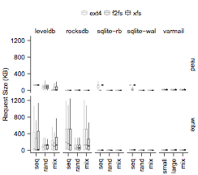
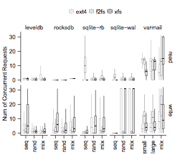
We evaluate request scale by request size and number of concurrent requests
Notes:
We evaluate request scale by request size and the number of concurrent requests. These two figures show the results of all the applications and file systems. Now let’s focus on these two parts. They show the results of insertions and background compactions of LevelDB and RocksDB. The median of the request sizes is only 100 KB. The median of the number of concurrent requests is only 2.

Slide 72
Request Scale
Observation 1 (App): Log structure increases the scale of write size of applications, as expected
Observation 2 (App): The scale of read requests is often low.
Observation 3 (App): SSD-conscious optimizations have room for improvements
Observation 7 (FS): FS log structuring fragments application data structures

Slide 73
We evaluate request scale by request size and number of concurrent requests
3
2
7
7
1
Notes:
We evaluate request scale by request size and the number of concurrent requests. These two figures show the results of all the applications and file systems. Now let’s focus on these two parts. They show the results of insertions and background compactions of LevelDB and RocksDB. The median of the request sizes is only 100 KB. The median of the number of concurrent requests is only 2.

Slide 74
Buffered read(): Page cache implementation splits and serializes user requests
App
read()
2MB
Page Cache
128KB
128KB
128KB
…
Surprise! Even reading 2MB in your app will not utilize SSD well.
Block Layer
SSD
128KB
128KB
128KB
Notes:
One reason for the low request scale is that page cache implementation splits and serialize user requests.
Both LevelDB and RocksDB use buffered read. When you read 2MB of data, page cache will issue a 128KB request to SSD one at a time. 128KB is the readahead size of the OS. Such design works OK for spinning disk because spinning disk is slow and can only process one request at a time. But 128KB request at a time is too small for SSD. Because of this, reading 2MB in your application will not utilize the SSD well.

Slide 75
Cause of Violation
Large reads are throttled by small prefetching (readahead).

Slide 76
Locality Observations
Observation 11(FS): Legacy policies could break locality
Observation 12 (FS): Log structuring is not always log-structured

Slide 77
FTL Miss Curves
11
Miss rate
12

Slide 78
Aligned Sequentiality
Observation 15 (FS): Log-structured file systems may not be as sequential as commonly expected - again!
App performs small overwrite, which triggers in-place updates

Slide 79
Unaligned Ratios
15

Slide 80
Death Time: Zombie Curves

Slide 81
Lifetime

Slide 82
Lessons Learned
The SSD contract is multi-dimensional
Optimizing for one dimension is not enough
We need more sophisticated tools to analyze workloads
Although not perfect, traditional file systems perform surprisingly well upon SSDs
Myths spread if the unwritten contract is not clarified
“Random writes increase GC overhead”
Notes:
We have learned several lessons from this study. First, the SSD contract is mutli-dimensional. So optimizing one dimension is not enough. Because it is complicated, we need more sophisticated tools to analyze the workloads.
We also learned that although not performance, traditional file systems, such as ext4 and XFS, perform well upon SSDs, mostly because HDDs share some contract rules with SSDs.
We also learned that myths spread if the unwritten contract is not clarified. For example, it is often believed that random writes increase GC overhead. Our study shows that they are irrelevant.

Slide 83
Conclusions
Understanding the unwritten contract is crucial for designing high performance application and file systems
System designing demands more vertical analysis
WiscSee (analyzer) and WiscSim (SSD simulator) are available at:
http://research.cs.wisc.edu/adsl/Software/wiscsee
Notes:
To conclude, in this paper, we reveal the five …

Slide 84
wisckey
LSM Tree(Log-structured Merge Tree，牺牲磁盘的读性能来换取写的顺序性)，
将对数据的修改增量保持在内存中，达到指定的大小限制后将这些修改操作批量写入磁盘，不过读取的时候稍微麻烦，需要合并磁盘中历史数据和内存中最近修改操作，所以写入性能大大提升，读取时可能需要先看是否命中内存，否则需要访问较多的磁盘文件。极端的说，基于LSM树实现的HBase的写性能比MySQL高了一个数量级，读性能低了一个数量级。
充分利用SSD的并行I/O
4个关键思想：
1.KV分离，key在LSM中，value在log中 （HHD->SSD, LSM->KV分离，LSM只放key，value放在log中）
2.对没排序的values，wisckey充分利用了ssd的随机read优势
3.独特的实现了crash一致性和垃圾回收技巧来有效的管理value log
4.wisckey去掉了LSM的log而没有牺牲一致性，优化了性能（减少小写的系统调用开销）。

